Slide 1
2025 Atlantic Hurricane Season Outlook
Georgia Emergency Management
& Homeland Security Agency
Will Lanxton
State Meteorologist

Slide 2
Are seasonal hurricane outlooks helpful?
They tell us the level of overall tropical activity expected across an entire basin for the whole season.
They give us a feel for how much more or less active a hurricane season might be.
They do NOT tell us where, when, or how many hurricanes could make landfall.

Slide 3
Primary Factors Driving an Outlook
Ocean Temperatures
Atlantic remains warmer than average but not quite as warm as last year
El Niño or La Niña?
Neither

Slide 4
Sea Surface Temperature Anomalies

Slide 5
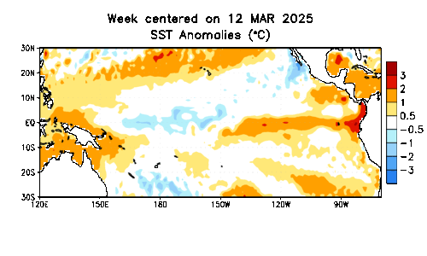
Sea Surface Temperature Anomalies

Slide 6
Most Likely Neutral

Slide 7
Most Likely Neutral
El Niño
Neutral
La Niña

Slide 8
NOAA’s Official Outlook

Slide 9
NOAA’s Official Outlook

Slide 10
What does this mean for us?
An above-average level of total tropical activity is expected across the Atlantic basin this season.
How do we prepare differently for an above-average season versus an average or below-average season?
Hurricane season is not a marathon—it’s an ultra-marathon. Don’t burn out early!

Slide 11
Atlantic Activity Campfire
10%
90%
8/20

Slide 12
Average Date of Storm Type
Number | Named systems | Hurricanes | Major Hurricanes
1 | Jun 20 | Aug 11 | Sep 1
2 | Jul 17 | Aug 26 | Sep 19
3 | Aug 3 | Sep 7 | Oct 28
4 | Aug 15 | Sep 16 | -
5 | Aug 22 | Sep 28 | -
6 | Aug 29 | Oct 15 | -
7 | Sep 3 | Nov 15 | -
8 | Sep 9 | - | -
9 | Sep 16 | - | -
10 | Sep 22 | - | -
11 | Oct 2 | - | -
12 | Oct 11 | - | -
13 | Oct 25 | - | -
14 | Nov 19 | - | -

Slide 13
Takeaways
The 2025 Atlantic hurricane season should be active – but probably not hyperactive.
Almost all significant tropical activity occurs after August 1st. Early season activity/non-activity is not a precursor for the overall season.
Try not to fall for the early-season hurricane hype. Trust official sources, and remember it’s an ultra-marathon. Pace yourself!

Slide 14
Questions?
www.gema.ga.gov (404) 635-7000 @GeorgiaEMA

